Slide 1
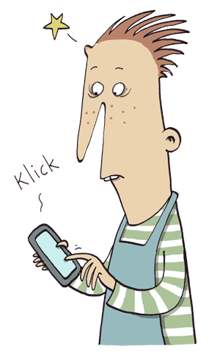
The IA app
A short introduction
Last update 5 april 2018

Slide 2
App configuration
– done by your super user
This presentation purpose is to give a short introduction to the app for your users. The super user needs to make some settings before you are ready to start. Here is some exemple of those settings:
Create an app-user account (see 4.2.8. Configuring an app-user account in Manual 2 –Administrators guide)
Select username and password and distribute them to users, or distribute a link with the log in details
Set app-user account language to make sure lists are shown in the language you want. The phones language setting only controls tool bars and menus.
Select which occurrence types that should be possible to report from the app
Create RM templates/checklists that are available from app (see chapter 5. Administering risk management in Manual 2 –Administrators guide)
The app can not be used from a IA test account.

Slide 3
Short about the app
The app can be downloaded for Android from Google Play, or for iPhone from App Store –this presentation shows the app in an iPhone
The app is available in 17 languages; Swedish, Danish, English, Estonian, Finnish, French, Simplified Chinese, Latvian, Lithuanian, Dutch, Norwegian, Polish, Romanian, Russian, Spanish, German, Ukrainian and Hungarian
To be able to use the app internationally there is a non-recurrent charge

Slide 4
Log in
Click on the screen shot below to start the video
Open App Store
Download the IA app
Log in through a) or b):
Fill in username and password that the super user registered for the app account
Click on the ”log in link” provided by the super user
Fill in your details
Click on Done (not ”Add account”)
Tip! Do not log out and you´ll see history of previously reported occurrences and checklists. Your personal details will be saved for next time.

Slide 5
First use -questions
Click on the screen shot below to start the video
Allow the IA app to see your location so your coordinates will be included with your report
Allow the IA app to access your pictures so you´ll be able to add them to occurrences and checklists
Allow the IA app to access your camera so you´ll be able to photograph and add pictures to occurrences and checklists

Slide 6
Report an occurrence
Click on the screen shot below to start the video
Choose what you wish to report
Choose where the occurrence occurred
If needed, change the accompanying information, injured person (only accident) time, or position pin on map
Describe the course of events –do not write names
Choose reason for injury/injury risk
Write your opinion of the cause of the event
Write your proposal on action to take
Send!
Tip! You can use dictation instead of writing in all the text fields.

Slide 7
Checklist
Click on the screen shot below to start the video
Choose which template to use
Choose where the checklist/risk management is to be done
Answer the questions by Yes or No. If any question is irrelevant you can answer with N/A (not applicable)
Click on the camera/ balloon icon to add a picture or a comment
Send!

